Slide 1
Vortex Compiler and OpenCL
Shinnung Jeong
Georgia Tech
MICRO Tutorial 2025
Notes:
Good morning, Im Shinnung Jeong from Georgia Tech.
In this talk, I will introduce the Vortex Compiler Toolchain structure and OpenCL compiler pipeline

Slide 2

What is the Open GPU Compilers’ Role?
__kernel void foo(){
tid = get_global_id(0);
…
barrier(…);
}
__host int main(){
…
cl_mem A_clmem = clCreateBuffer(context, …); clEnqueueNDRangeKernel(command_queue, …); …
}
Vringo
SkyBox
GPU Compiler
Code Opt and Binary Generation
SparseWeaver
SW-Side Consideration
Diverse Programming Languages (e,g OpenCL, CUDA)
Handle Runtime info & Special Kernel Functions & Program Flow
Host Runtime Functions for communication
HW-Side Consideration
Flexible Hardware & Microarchitecture & Number of HW Component
Flexible ISA & Runtime
Notes:
So, the main goal of Vortex is to leverage the RISC-V ecosystem to bring the benefits of the SIMT execution model while providing a customizable GPU design that supports architectural research and experimentation.
As shown on the right, several Vortex extension have been developed or proposed, and many more studies are currently underway. These designs share a common Vortex architecture, but each can include additional microarchitectural variations, allowing researchers to reconfigure components flexibly across the entire stack.
These GPUs use the Vortex ISA, and it’s also possible to define custom ISA extensions for specialized microarchitecture support. So, there’s a diversity and flexibility on the hardware side.
Now, if we look at the software side, developers use GPU programming languages like OpenCL or CUDA to build their applications.
Many individuals employ languages like OpenCL and CUDA for writing their applications, and numerous applications have already been developed using these languages. These languages typically separate the program into two parts: the kernel code and the host code.
The kernel code handles runtime information—such as global or thread IDs—and includes synchronization primitives like barriers and control flow operations. Also they have some special kernel functions. Meanwhile, the host code is responsible for communicating with the GPU, managing memory, and launching kernels.
Definitly, there’s still a large gap between what programmers write and how the hardware actually executes the code. All this high-level code must be lowered to the hardware driver and ISA, especially when we need to efficiently support diverse extensions and flexible architectures.
And this is exactly where the GPU compiler comes in — to bridge that gap between flexible hardware and high-level GPU programming languages.

Slide 3
Design Goal of Open GPU Compiler
Openness
Encourages accessibility, reproducibility, and community collaboration
Portability
Ensures operability across diverse hardware and platforms
Enables reuse of high-level optimizations through abstractions that decouple them from backend-specific behavior
Composability
Supports flexible assembly of compiler components through loose coupling and clear interfaces
Allows independent development and rapid prototyping in fast-evolving environments
Maintainability
Facilitates easy understanding, modification, and extension over time
Leverages existing open-source components to ensure long-term sustainability
Notes:
So, when building a compiler to support both considerations, what should we set as our design goals?
First, our primary goal is openness. Just like the Vortex GPU itself emphasizes openness, our compiler also aims to encourage accessibility and community collaboration, making it easier for researchers and developers to contribute.
Second, we focus on portability. Since both programming languages and hardware extensions are highly diverse, our compiler is designed to support different frontends and backends. In particular, we try to decouple common optimizations from target-specific implementations so that they can be reused across various hardware extensions.
Another key design goal is composability. We want compiler components to be flexibly assembled through loose coupling and clear interfaces, which allows independent development and rapid prototyping — something crucial in a fast-evolving research environment.
Finally, we emphasize maintainability. Because the compiler must cover a wide software stack — from high-level abstractions down to hardware binaries — while often being developed by small research teams, maintainability is essential. By leveraging existing open-source components, we can ensure long-term sustainability and efficient development.

Slide 4
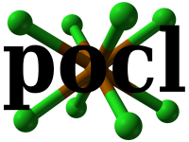



Vortex-Optimized Lightweight Toolchain (VOLT)
Existing
Open-Source
Compilers
VOLT
Compilers
for other
Open GPUs
✓ Portability
✓ Composability
✓ Maintainability
+ Leverage existing
Infrastructures
+ Reuse opts
+ Port open
GPU opts
Front-end Compilers
Middle-end Compiler
Back-end Compiler
CuPBoP
Hierarchical Compiler Design
Notes:
Based on these design goals, we present VOLT — the Vortex-Optimized Lightweight Toolchain.
To ensure maintainability, we build on existing open-source compiler infrastructures and leverage their optimization frameworks. By doing so, we can reduce development effort while ensuring long-term sustainability.
We also try to design VOLT to be portable across different open GPU architectures — not only for Vortex, but also for other RISC-V–based GPUs.
The Volt compiler itself adopts a hierarchical design. We integrate PoCL and CuPBoP, two open-source compilers, to support OpenCL and CUDA respectively. For a more flexible and extensive infrastructure, we employ LLVM as the middle-end compiler. Finally, we modify the LLVM RISC-V backend to generate Vortex GPU binaries

Slide 5





Overview of VOLT
Blue boxes introduced or extended for Open GPU support
GPU Kernel
Middle-end Compiler
Front-end Compiler
General Code Optimizations
CuPBoP
Divergence Management
IR Generator
Divergence Tracker
Semantic-aware Code Optimization
Uniformity Analysis
Opt and Transformation
Memory Structure Handling
Divergence Management Function Insertion
Function Call Analysis
Built-in library
Back-end Compiler
Built-in Library Linking
Target Code Generation and Optimization
Vortex ISA Table
Thread Scheduling Code Generation
Thread Scheduling & Spawn Code Insertion
Vortex Binary
Notes:
We also have a more detailed overview here. The blue boxes indicate the components that we have modified and implemented to support the Vortex GPU.
Starting with the frontend compiler — its goal is to analyze program semantics and generate LLVM IR that reflects the SIMT execution model. To achieve this, we extended several key components, such as memory structure handling, hardware-specific library support, and SIMT –aware code generation mechanisms.
Next, in the middle-end compiler, we implemented optimizations that can be applied across different GPU targets. These include general code optimizations, but more importantly, they also include divergence management, which is one of the most critical aspects of managing SIMT programs.
Finally, in the backend, we extended the ISA tables and added intrinsics to enable code generation that targets the Vortex ISA specifically.

Slide 6
PoCL: Portable OpenCL Compiler
Key Insight
Use target-specific execution model
SIMT -> GPUs
MIMD, SIMD -> CPUs
Target-specific compiler transformations
Using LLVM
Key Features
A single interface with multiple target devices
Support x86, PTX, HASIL export
Support Custom accelerator support via TCE
OpenCL Program
PoCL
PoCL Built-in lib
PoCL Devices
(CUDA,TCE …)
LLVM
PoCL Software Stack
Notes:
Now I briefly introduce the Vortex PoCL extension, which is designed to enable support for OpenCL programs on the Vortex platform.
PoCL is a project to support executing OpenCL programs on different hardware device.
It is built upon two fundamental insights: the adoption of a target-specific execution model and the implementation of target-specific compiler transformations through LLVM.
Based on key insight, they can support different execution model per device such as GPU and CPU, also they can optimize and generate binary code for specific target.
PoCL extends its support to several backend devices, including x86, NVIDIA GPUs, and custom accelerators.
To execute an opencl programs on a backend device.
First, POCL compiles the program, and link it with hardward dependent runtime library
and also PoCL’s builtin library such as math functions.
Then, the POCL runtime will use the devices runtime functions to control the devices.

Slide 7
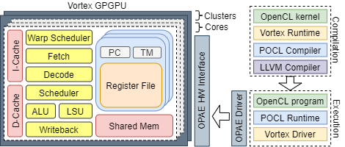
Vortex OpenCL System Architecture
Compilation
Vortex Kernel Library
PoCL Compiler
Execution
Vortex Runtime
PoCL Runtime
Notes:
The vortex PoCL extension make available compile OpenCL kernel and execute them in the vortex GPU.
we need to care about the following parts: for compilation, we need to modify the POCL Compiler and provide a Vortex Kernel library.
For the Compilation, vortex have our middle-end and back-end compiler.
thus, we have to modify the original pocl compiler to generate the programs with Vortex ISA with these compiler.
We also use vortex kernel library in lowering process by extending built-in library of PoCL.
For execution, we need to provide a Vortex runtime for POCL runtime. To integrate a new device into POCL, we have to implement some basic operations, like memory copy, memory allocation and kernel launch and put all these functions into Vortex Runtime. POCL framework will use the Vortex Runitme to control and communicate with Vortex.

Slide 8
PoCL: Mapping from OpenCL to Vortex
OpenCL processing model
Work-Item
Work-Group
Kernel instance
Total Hardware Threads
Cores x Wavefronts x Threads
Work-Item
Work-Group
…
Kernel Instance
Notes:
While compile program for the vortex, one the most important parts is thread scheduler.
How to map computation to hardware is critical for achieving high performance.
The OpenCL processing model using three terms for specifying processing model, work-item, work-group, and kernel instance.
The work-item specifying the minimal unit of program. The work-group specifying the minimal group of program that processing in the one processing unit.
Instead of work-item and work-group, vortex use wavefront and thread to schedule.
A wavefront is a group of thread and threads within one wavefront are executed in parallel and in lock steps.
In Vortex, we use wavefront as. the unit for scheduling.
The goal of the scheduling is that high-level users can directly execute Vortex without worry about scheduling.
So, we generate scheduling in the compilation process.

Slide 9
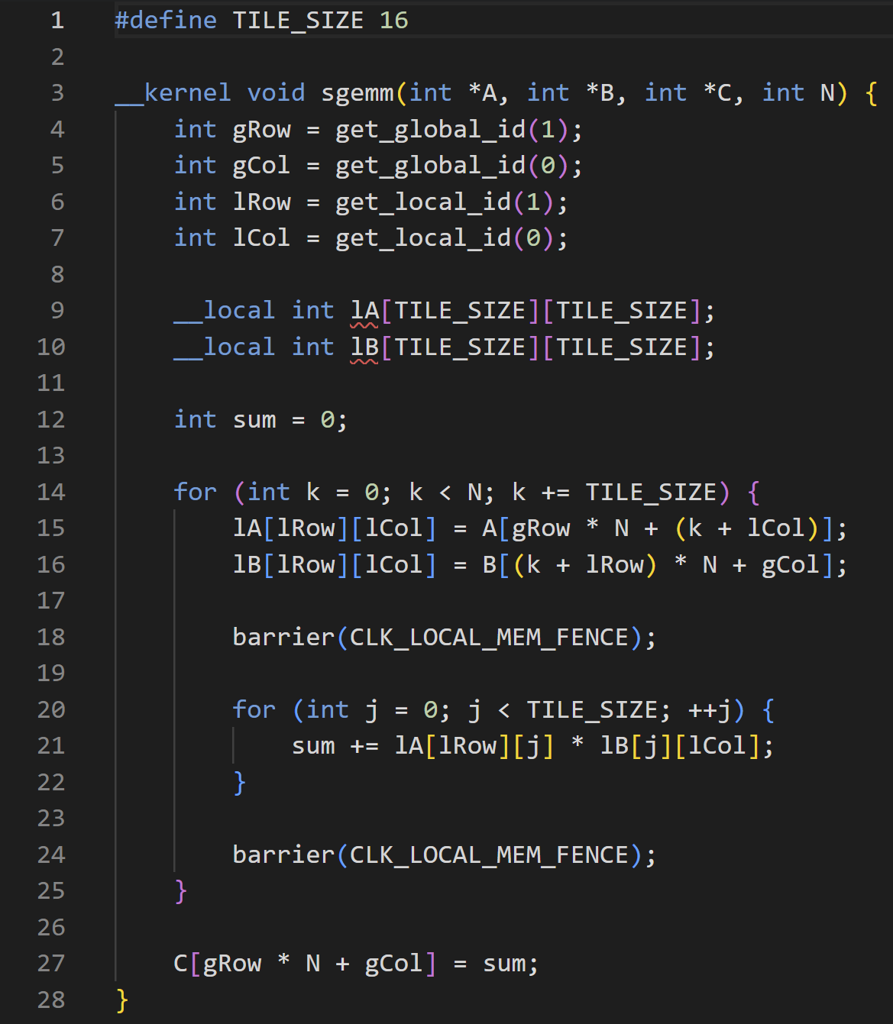
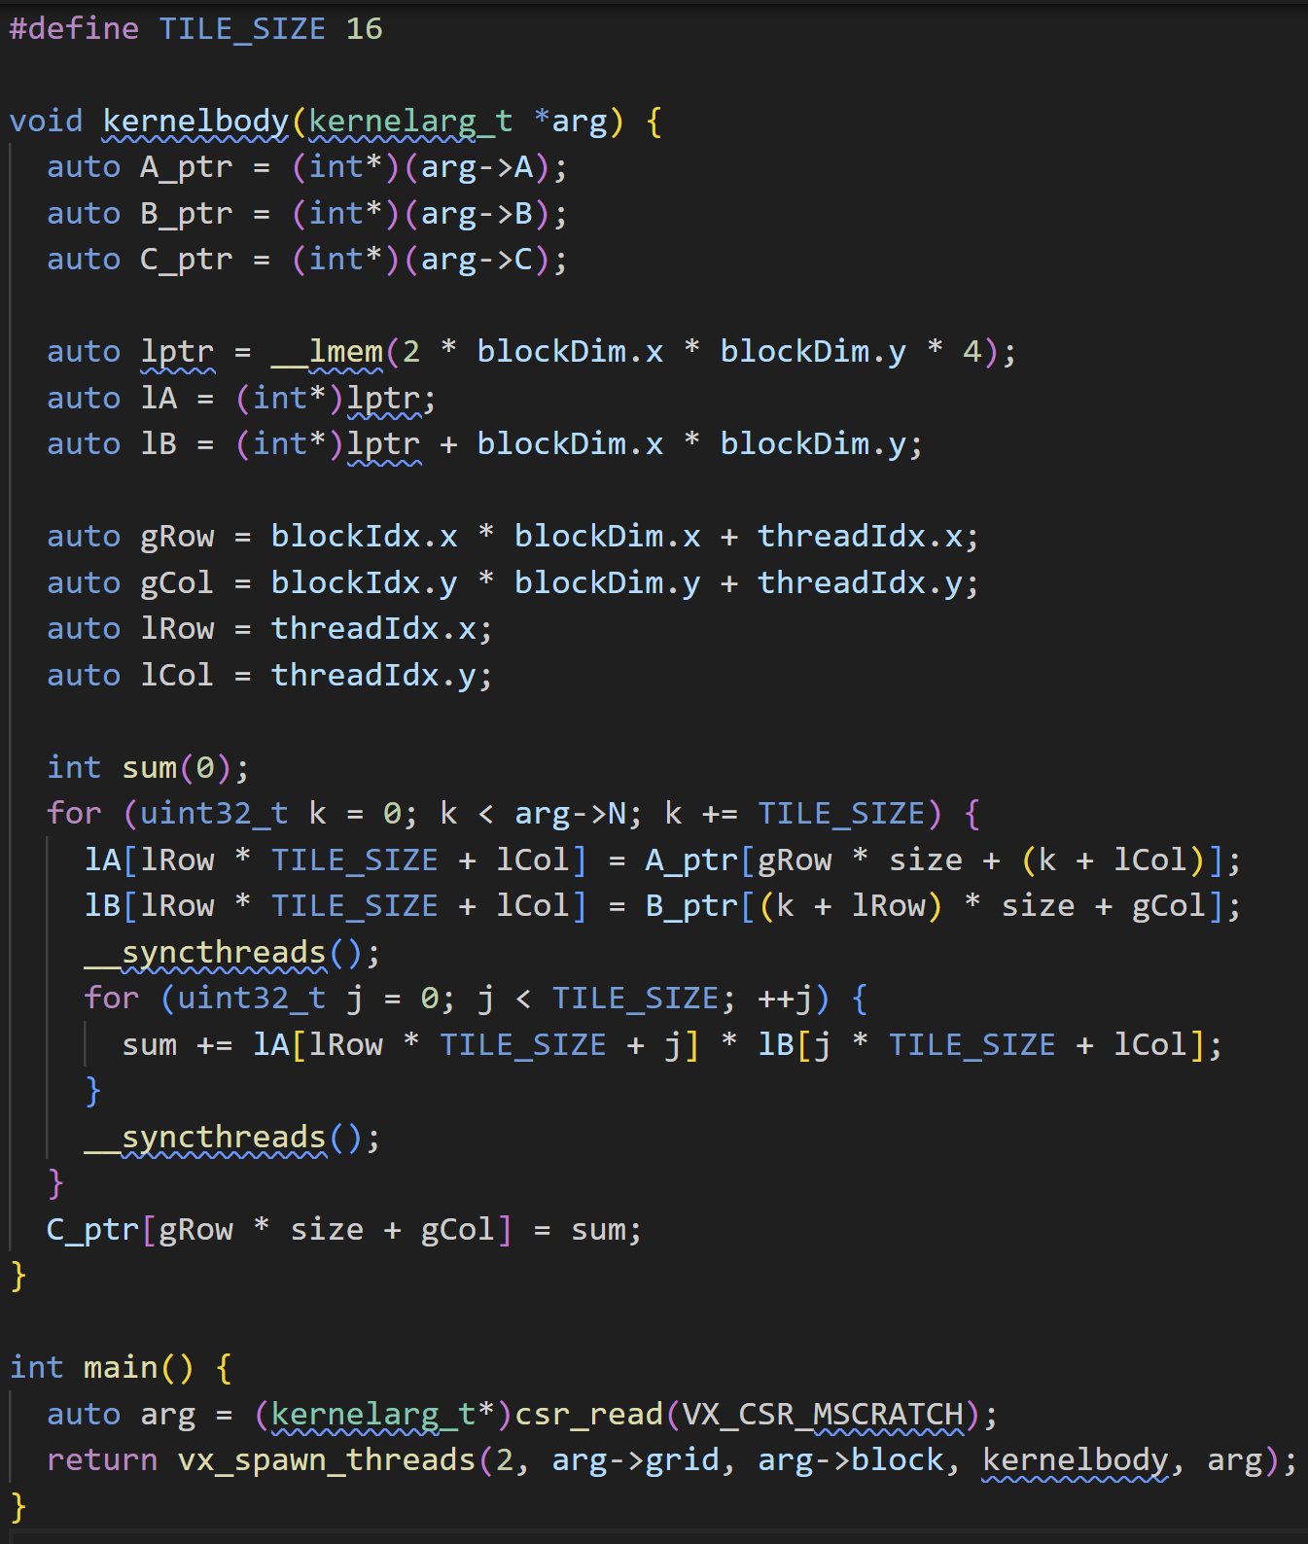
PoCL: Compilation Flow Example
PoCL Passes
OpenCL Sgemm Kernel
Converted Kernel
Kernel Arguments Translation
Work-item coordinates Translation
Memory Structure Handling
Built-in Library Linking
(Barrier)
Thread Scheduling & Spawn Code Insertion
Notes:
So, the overall compiler flow can changed code like this. First, it checks the kernel arguments and work-item coordination, then performs the corresponding translation. Next, it handles memory structures and lowers kernel functions by utilizing built-in libraries. Finally, it inserts thread scheduling and spawn codes to complete the GPU execution model.

Slide 10


PoCL: Thread Scheduling & Spawn
Warps per Group
Calculation
$$\frac{Group Size}{threads_per_group}$$
Active Cores
Calculation
$$min⁡(\frac{num_{groups}∗warps_per_group}{warps_per_cores}, num_{cores})$$
Workgroups to Active Cores Assignment
(group_offset, num_groups)
Warp Iterations Calculation
(remaining groups)
Spawn Warps
(warps execution)
Notes:
With this work-group function, one of the simple method to execute program on the vortex is thread mapping.
Every thread execute workgroup function, which means mapping one work-group to one hw thread.
The workgroup is distribute among all threads.
Using the given mapping, it is possible that the number of work-groups is not a multiple of the number of threads in a wavefront.
To execute the remaining work-groups, we make the program flow as shown in the right figure, add additional wavefront for dealing remaining work-group.

Slide 11
LLVM: Compiler Extension
New RISCV target feature to identify Vortex
Toolchain integration
GCC toolchain
Kernel runtime
Assembler/Disassembler
GPGPU ISA Extension
wspawn, tmc, split, join, pred, bar, tex
Add new LLVM Optimization Passes
Raise common analysis and optimization to LLVM level
Especially, Divergence Management Passes
Notes:
Furthermore, we have extended the LLVM compiler to generate Vortex ISA code.
Additionally, we integrated the GCC toolchain and kernel runtime into LLVM, and we have enhanced the assembler and disassembler to provide full support for Vortex ISA.
Moreover, we have introduced an optimization pass to manage thread divergence. This pass effectively inserts split and join instructions into regions where divergence occurs.

Slide 12
Thread Divergence in SIMT
A
Divergent branch!
Key Difference: SIMD vs. SIMT
SIMD: A single program counter executes one instruction across multiple data elements
SIMT: Multiple wavefronts execute in lockstep, each with its own PC and stack
Handling Divergent Control Flow
SIMD: Divergent branches are serialized within a single thread context
SIMT: Different wavefronts can execute divergent branches independently
Within a wavefront, only active threads execute the branch
B
If (threadid.x<2) {
work B
} else {
work C
}
C
D
Notes:
To manage SIMT execution on GPUs, handling thread divergence is extremely important.
We can understand why by comparing SIMD and SIMT.
In SIMD, a single program counter executes one instruction across multiple data elements. In contrast, SIMT executes multiple wavefronts in lockstep, each maintaining its own program counter and stack.
Because of this structural difference, divergence handling becomes critical.
When divergence occurs, SIMD simply serializes the divergent branches within a single thread context. However, in SIMT, the hardware must create different wavefronts and execute each divergent branch independently.

Slide 13
Thread Divergence in Vortex GPU
A
Divergent branch!
Hardware-Level Divergence Management
Use the Immediate Post-Dominator (IPDOM) stack to ensure correct divergence and reconvergence after branches
Required GPU ISA Support
Define wavefront spawn points - launch configuration and initial PC
Provide thread mask operations - set/retrieve active threads
Include explicit branch and reconvergence instructions for hardware control
B
If (threadid.x<2) {
work B
} else {
work C
}
C
D
if(r1){
++r2;
}else{
--r1;
}
vx_split r0, r1
bne r1, #0, @then
@else: subi r2, r2, #1
j @join
@then: addi r2, r2, #1
@join: vx_join r0
while(r1 != 0){
++r2;
--r1;
}
seqz r3, r1, #0
vx_split r0, r3
bne r3, #0, @join
@phead: vx_tmask r4
@body: add r2, r2, #1
subi r1, r1, #1
cmp r3,r1, #0
vx_pred r3, r4
bne r3, @body
@join: vx_join r0
Notes:
Because of this, managing divergence requires hardware support. In the case of Vortex, we added an ipdom stack to track divergence and manage reconvergence points.
This mechanism is also exposed through the ISA, allowing the hardware to control divergence explicitly. For example, a split instruction is inserted where divergence occurs, and a join instruction is added where the control flow reconverges.
Handling loops, however, introduces additional complexity compared to simple divergences like if/else constructs. To address this challenge, we introduced vx_pred, which allows us to modify the thread mask dynamically based on given conditions.
In the figure on the lower-right, you can see how if/else statements are transformed into split and join instructions depending on conditions. Similarly, for loops, the optimization pass inserts split and join instructions at the beginning and end of the loop, while adding vx_pred to handle condition changes inside the loop body.

Slide 14
LLVM: Vortex Divergence Management
Uniformity Analysis
Mark divergent instructions and always uniform instructions
Based on the LLVM Uniformity analysis structure
Divergence Tracker
Mark Function arg, returns, Atomic as Divergent
Mark Control and Status Register info as Uniform
Annotation analysis
Function argument analysis
Uniformity Analysis
Optimization & Transformation
Divergence Management Function Insertion
Notes:
Such divergence requires additional management and often leads to idle threads, which can have a significant impact on performance. Therefore, whenever we detect uniform variables—that is, variables not cause divergence across all threads—and find that they are used in branches or loops without divergence. we can skip inserting divergence management code to prevent unnecessary performance overhead.
To effectively manage divergence, we have introduced two main compiler passes: a divergence analysis pass and a divergence management pass.
Through the analysis pass, the compiler identifies and marks divergent instructions within the program. To support this process, we introduced a divergence tracker, which helps find uniform variables by analyzing program information and hardware register accesses. Additionally, we implemented annotation analysis and function argument analysis to enhance the accuracy of divergence detection.

Slide 15
LLVM: Vortex Divergence Management
Divergence Optimization
Code Simplification
Control-Flow Structurization
Control-Flow Graph Linearization
Control-Flow Reconstruction
Divergence Intrinsic Insertion
Insert vx_split and vx_join instruction
Handling loops is more complex
Use vx_pred to disable threads on conditional
Uniformity Analysis
Optimization & Transformation
Divergence Management Function Insertion
Notes:
Also we add divergence management optimizations and code transformation.
And intrinsic insertions

Slide 16
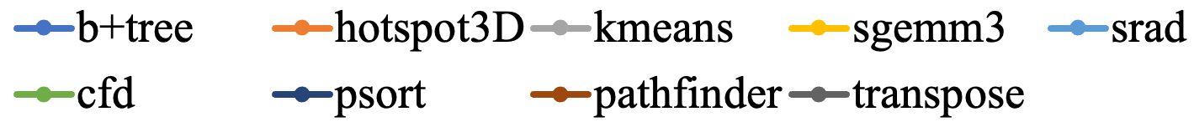
LLVM: Vortex Divergence Management
Notes:
This graph shows the effectiveness of our optimization passes. Overall, these passes contribute to instruction reduction and lead to noticeable performance speedups.
However, they are not always effective in every case. In some workloads, the optimizations can increase memory request density, which may decrease overall performance instead.

Slide 17
Supported OpenCL benchmarks
Upgrade PoCL version as 4.0
Support OpenCL 3.0
Using llvm vortex based on llvm v18
17 Benchmarks available in codebase
vecadd, sgemm, psort, saxpy, sfilter, conv3, oclprintf
nearn, gaussian, dotproduct, kmeans, spmv, bfs,
stencil, lbm, blackscholes, transpose

Slide 18

How to Install PoCL Pipeline
Toolchain Build Instruction

Slide 19
Thank you ☺
Shinnung Jeong
sjeong306@gatech.edu
Notes:
Good morning, Im Shinnung Jeong from Georgia Tech.
In this talk, I will introduce the Vortex Compiler Toolchain structure and OpenCL compiler pipeline

